Slide 1
Development Team:
Koung
Nicholas
Jateni Dida
Norin Chea
House Prices: Advanced Regression Techniques
Professor:
Mohammad Pourhomayoun

Slide 2
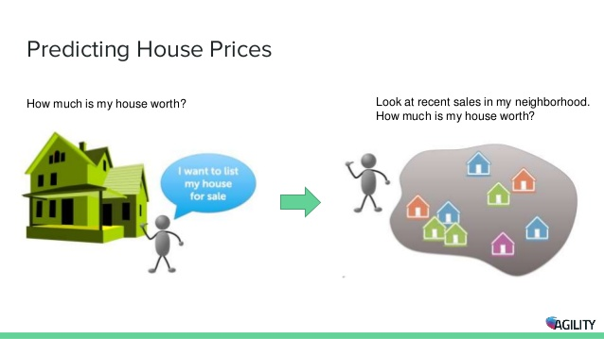
Project Requirement
we intend to use various variables to be able and determine the sale price of a house.
A training and testing data is provided along with the description of each column or variable used to determine the price of the house.

Slide 3

Project Goals
To predict the sales price for each house.
To find out how to reduce features, which also include numeric and string data
For each Id in the test set, we intend to predict the value of the Sale Price variable.

Slide 4
Features
Due to having 80 features, we intended to reduce the features down to 20
But, because there were many features that had data that were strings, we had trouble reducing the features
df = pd.get_dummies(df) was used to transform the string data into numerical data
Without removing the features, the results from applying algorithms to a lot of features gave results that were very inaccurate.
df = pd.get_dummies(df) creates more columns, which resulted in logistic regression taking a long time to finish with all the data we had to fit and run

Slide 5
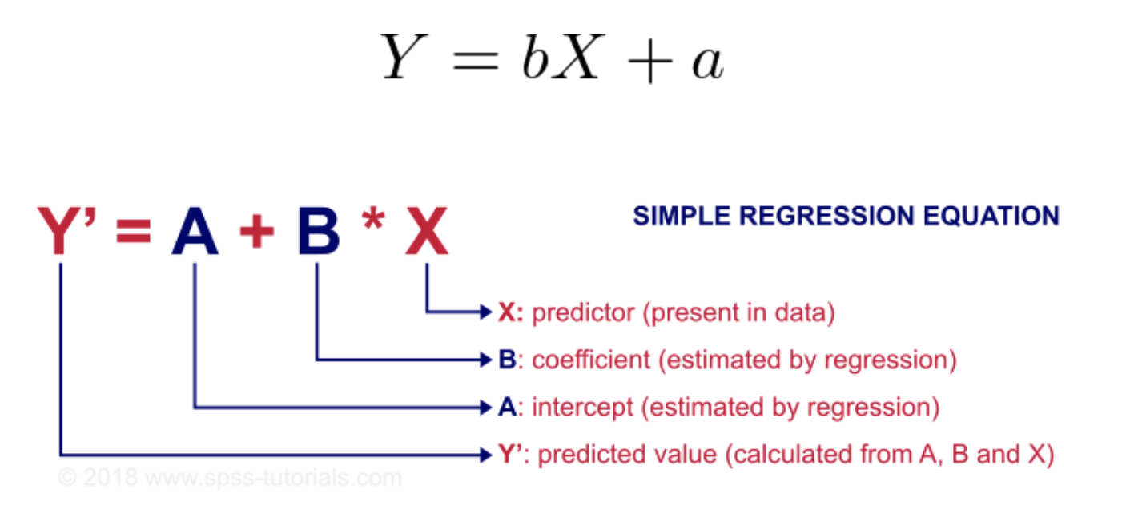
Simple Linear Regression
Simple linear regression uses a traditional slope-intercept form, where a and b are the coefficients that we try to “learn” and produce the most accurate predictions.
X represents our input data and Y is our prediction.
Linear regression produces continuous output.

Slide 6
Linear Regression Accuracy for House Price
The Linear Regression model uses a filtered feature set of eight elements that best describes the house that is going to be sold. Some of the features are: the year the house was built, the lot area, screen porch and so on.
We have used the sale price as a target for the linear regression model.
We have also calculated the Root mean square error (RMSE) of the Linear regression model on the eight selected features and got a score of 68053.7672689169, which indicates the accuracy to be way off.
Even with 10-fold cross validation, we ended up with an even more inaccurate score of 189698538.42772207

Slide 7
Logistic Regression Accuracy for House Price
The logistic regression model typically predicted the cost of a house with an error of at least $30,000. This pattern was consistent with many values which indicates that the error may have been smaller if we added 30,000 to the logistic regression output.
Logistic regression did not predict the values very well because it is an algorithm meant for predicting binary output. Our group ran logistic regression to show the effect of running this algorithm with respect to an algorithm like linear regression which is meant to predict continuous output rather than discrete output.
Our logistic regression classifier scored .00684931506849315

Slide 8
Random Forest
We used Random Forest regression since the target variable is a continuous real number.
We have splitted the train set into a train and a test set to find the accuracy with the score of 0.02054794520547945

Slide 9
Decision Tree Classifier
The decision tree classifier gave us an accuracy score of 0.0136986301369863
With that being our last test, we have concluded that the best score actually came from 10-fold cross validation from logistic regression with a mean accuracy of 0.025892741822205422

Slide 10
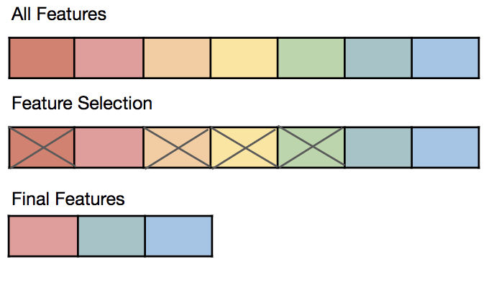
Feature Selection Technique (What we are planning to do)
Since there are 79 features in Test dataset and 80 features in Train dataset, we decide to use Feature Selection Technique.
It is the process where we automatically or manually select those features which contribute most to our prediction variable or output in which we are interested in.

Slide 11
Conclusion
Logistic regression did not perform very well since it is meant to produce discrete output as opposed to an algorithm such as linear regression.
But, 10-fold cross validation on logistic regression did perform the best
The decision tree on its own did not perform well.
Overall we find Random Forest Classifier is the most efficiency model, when 10-fold cross validation was omitted, among other because it builds multiple decision trees and merges them together to get a more accurate and stable prediction.

